Slide 1


PAMPANGA
SURVEILLANCE UPDATE
August 15 – 21, 2021
Central Luzon Center for Health Development
Department of Health, Philippines

Slide 2


Central Luzon Center for Health Development
Department of Health, Philippines

Slide 3
Central Luzon Center for Health Development
Department of Health, Philippines

Slide 4
Central Luzon Center for Health Development
Department of Health, Philippines

Slide 5
Central Luzon Center for Health Development
Department of Health, Philippines

Slide 6
COVID-19 Confirmed Cases by Disposition Central Luzon, as of August 21,2021
RECOVERIES | DEATHS | ACTIVE
31,051 (80.43%) | 1,832 (4.74%) | 5,725 (14.83%)
Central Luzon Center for Health Development
Department of Health, Philippines

Slide 7
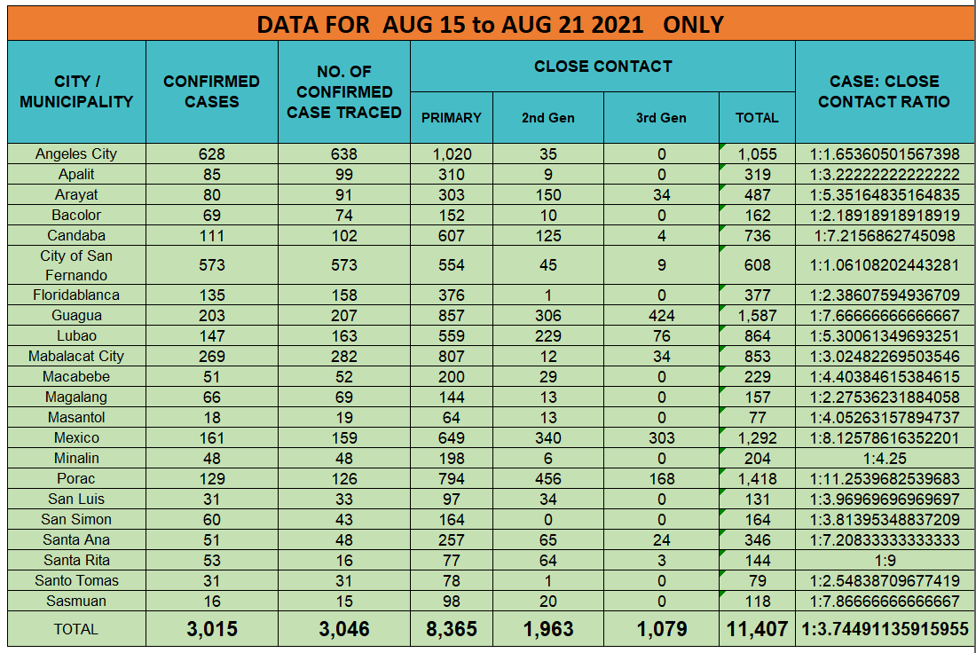
Central Luzon Center for Health Development
Department of Health, Philippines

Slide 8
Note: No Report received from Mabalacat from PESU and LGU
Central Luzon Center for Health Development
Department of Health, Philippines

Slide 9
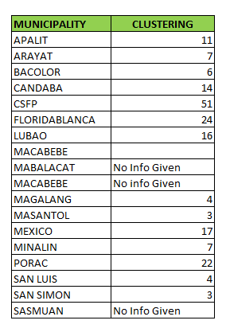
TOTAL NUMBER OF ACTIVE CASES WITH CLUSTERING FOR AUGUST 15-21, 2021
Numbers on the right are based from detailed address of Barangay
Central Luzon Center for Health Development
Department of Health, Philippines

